Slide 1
Chapter 15 Multithreading, Networks, and Client/Server Programming
Fundamentals of Java: AP Computer Science Essentials, 4th Edition
Lambert / Osborne

Slide 2
Objectives
Describe what threads do and explain the advantages of multithreading
Explain how threads are manipulated in an application
Code an algorithm to run as a thread
Use conditions to solve a simple synchronization problem with threads
‹#›
‹#›

Slide 3
Objectives (continued)
Use IP addresses, ports, and sockets to create a simple client/server application on a network
Decompose a server application with threads to handle client requests efficiently
Restructure existing applications for deployment as client/server applications on a network
‹#›
‹#›

Slide 4
Vocabulary
client handler
context switch
IP address
IP name
IP number
lock
monitor
multithreading
parallel computing
port
ready queue
server daemon
‹#›
‹#›

Slide 5
Vocabulary (continued)
socket
synchronized method
Synchronization problem
time slicing
‹#›
‹#›

Slide 6
Introduction
Threads are processes that can run concurrently to solve a problem.
Threads can be organized in a system of clients and servers.
Example: A Web browser runs in a client thread and allows users to view Web pages sent by a Web server, which runs a server thread.
Multithreading: running client and server threads concurrently on a computer or network.
‹#›
‹#›

Slide 7
Threads and Processes
Algorithm: a computational process that runs to completion.
A process consumes resources, such a CPU cycles and memory.
When a program runs, the process associated with the program is not the only one running on your computer.
Programs can also include concurrent processes.
‹#›
‹#›

Slide 8
Threads and Processes (continued)
Time-sharing systems (1950s-60s): allowed several programs to run concurrently. Users logged in via remote terminals. The operating system created processes, and worked with the CPU and other resources.
Today in the form of Web, e-mail, and print servers.
‹#›
‹#›

Slide 9
Threads and Processes (continued)
Multiprocessing systems (1980s): a single user running several programs using a desktop.
Forking: the ability of a program to start another program.
Networked or distributed system (late 1980s, early 90s): CPUs linked by high-speed communication lines.
‹#›
‹#›

Slide 10
Threads and Processes (continued)
Parallel computing: the discipline of building hardware architectures, operating systems, and specialized algorithms for running a program on a cluster of processors.
Threads:
Threads are used to describe processes.
The JVM uses threads: the garbage collector runs as a separate thread from the main Java application.
‹#›
‹#›

Slide 11
Threads and Processes (continued)
Threads (cont):
In Java, a thread is an object.
It can hold data, receive messages, be stored in data structures, and be passed as parameter to a method.
Threads can also be executed as a process after the thread’s class implements a run method.
Threads can enter various states.
Ready queue is a data structure.
CPU is a hardware resource.
‹#›
‹#›

Slide 12
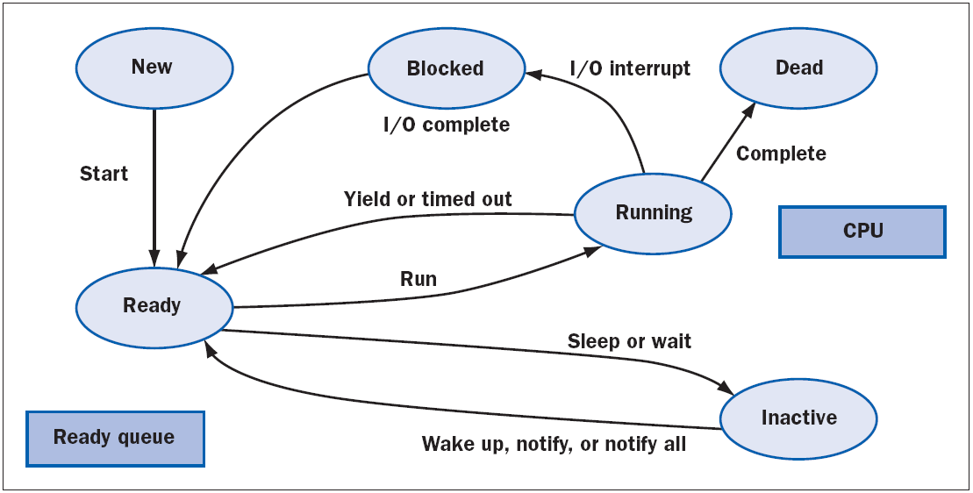
Threads and Processes (continued)
Threads (cont):
States in the life of a thread
‹#›
‹#›

Slide 13
Threads and Processes (continued)
Threads (cont):
After a thread is created, it is inactive until someone runs its start method.
Makes it ready for execution and puts it in a queue.
Ready queue: threads ready for execution.
After the thread starts to run, it can have problems that lead to being sent to the rear of the ready queue.
Time slicing: the process of timing out. Pauses execution.
‹#›
‹#›

Slide 14
Threads and Processes (continued)
Threads (cont):
Sleep: puts to sleep for milliseconds.
Block: thread waiting for an event, such as user input.
Wait: voluntarily relinquish the CPU to wait for a condition to be true.
Context switch: the process of saving or restoring a thread’s state.
After the last instruction in the run method has executed, the thread dies as a process, but continues to be an object.
‹#›
‹#›

Slide 15
Threads and Processes (continued)
Threads (cont):
The most common way to create a thread is to define a class that extends Thread.
The new class should include a run method that executes the algorithm in the new thread.
Sleeping Threads:
When a thread goes to sleep, the next thread can acquire the CPU.
The size of the sleep interval determines the order in which threads are woken up.
‹#›
‹#›

Slide 16
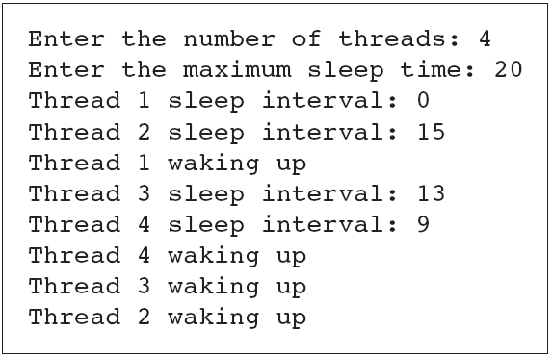
Threads and Processes (continued)
Sleeping Threads (cont):
A run of the sleeping threads program
‹#›
‹#›

Slide 17
Threads and Processes (continued)
Producer/Consumer Threads and Synchronization:
Producer/consumer relationship: when threads interact by sharing data, like an assembly line.
A producer must produce an item before a consumer consumes it.
Each item must be consumed before the producer produces the next item.
A consumer must consume each item just once.
‹#›
‹#›

Slide 18
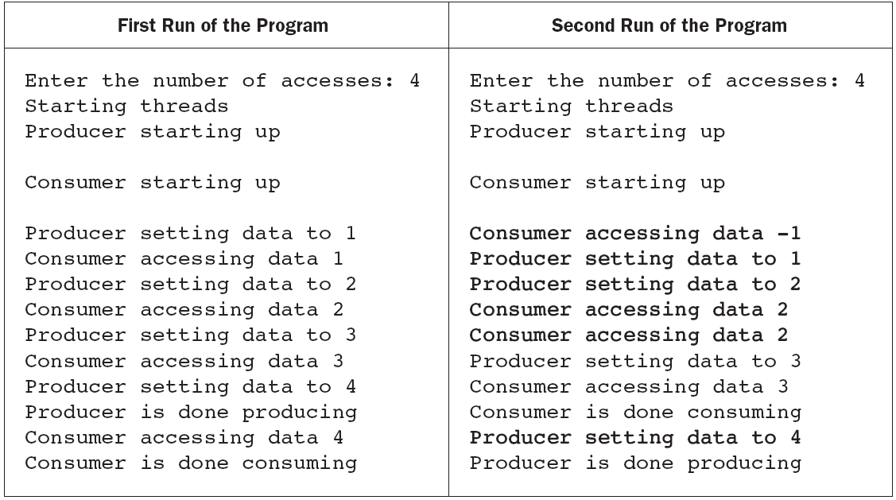
Threads and Processes (continued)
Producer/Consumer Threads and Synchronization (cont):
Two runs of the producer/consumer program
‹#›
‹#›

Slide 19
Threads and Processes (continued)
Producer/Consumer Threads and Synchronization (cont):
Synchronization problems with the second run of the program:
The consumer accessed the shared cell before the producer wrote the first datum.
The producer writes two consecutive datum before the consumer accessed the cell again.
The consumer accessed data 2 twice.
The producer writes data 4 after the consumer is finished.
‹#›
‹#›

Slide 20
Threads and Processes (continued)
Producer/Consumer Threads and Synchronization (cont):
Producer and Consumer threads must synchronize their actions.
The shared cell must be in one of two states:
Writable or not writable.
Conditions control the callers of setData (producer) and getData (consumer).
Writable: getData must wait for consumer to write.
Not writable: setData must wait until consumer reads datum.
‹#›
‹#›

Slide 21
Threads and Processes (continued)
Producer/Consumer Threads and Synchronization (cont):
Monitor: an object on which a process can obtain a lock.
Lock: prevents another process from accessing data in the monitor until a condition is true.
Synchronized method: the code runs as an indivisible unit.
A second thread cannot execute method until first thread has completed executing the method.
‹#›
‹#›

Slide 22
Threads and Processes (continued)
Producer/Consumer Threads and Synchronization (cont):
The methods wait and notify suspend and resume the execution of the calling thread.
Wait must be invoked within a try-catch statement.
The producer/consumer problem can involve multiple producers and/or consumers.
‹#›
‹#›

Slide 23
Networks, Clients, and Servers
The resources required to run client/server applications or process are: IP addresses, sockets, and threads.
IP Addresses:
IP number: ddd.ddd.ddd.ddd.
IP name: for example, www.wwu.edu.
Java uses InetAddress for IP addresses.
‹#›
‹#›

Slide 24
Networks, Clients, and Servers (continued)
IP Addresses (cont):
When developing a network application, the programmer can first try it on a local host, then change the IP address to deploy over the Internet.
Ports, Servers, and Clients:
Port: a channel through which several clients exchange data with the same or different servers.
‹#›
‹#›

Slide 25
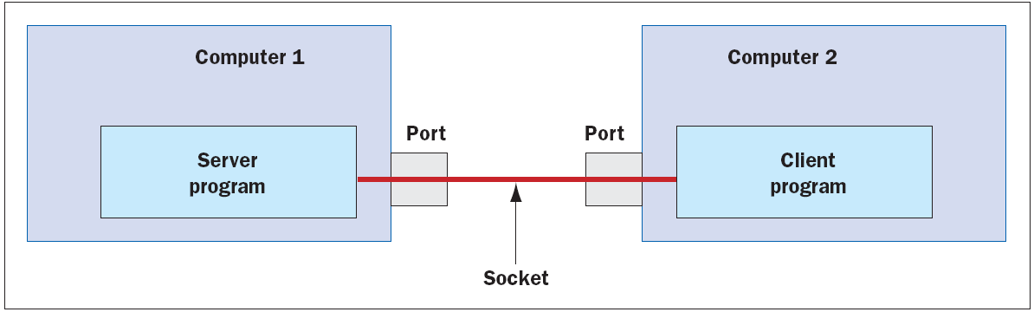
Networks, Clients, and Servers (continued)
A Day/Time Service:
Ports and sockets
‹#›
‹#›

Slide 26
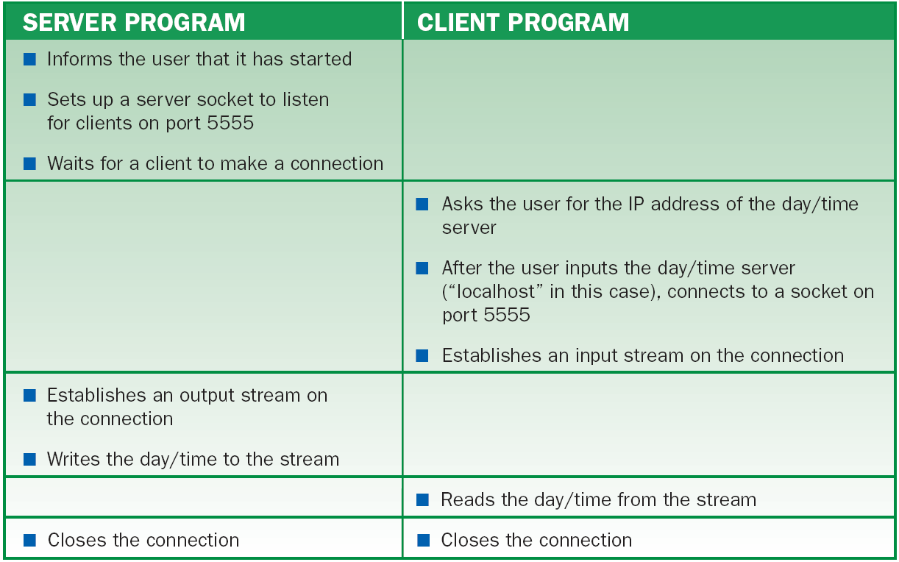
Networks, Clients, and Servers (continued)
A Day/Time Service (cont):
The sequence of events for the day/time service
‹#›

Slide 27
Networks, Clients, and Servers (continued)
A Day/Time Service (cont):
An exception is thrown if there is a connection error, such as an unrecognized host.
Making the Server Handle Several Clients:
Most servers run an infinite command loop to take requests from an arbitrary number of clients.
‹#›
‹#›

Slide 28
Networks, Clients, and Servers (continued)
Making the Server Handle Several Clients (cont):
Using a while (true) loop can handle multiple requests, but creates problems.
The main application in which the server runs cannot quit.
The main application cannot do anything but run the server.
Only one client can be handled at a time.
‹#›
‹#›

Slide 29
Networks, Clients, and Servers (continued)
Using a Server Daemon and Client Handlers:
Server daemon: a thread that listens indefinitely for client requests, but doesn’t handle them directly.
Client handler: a thread that handles the client’s request.
‹#›
‹#›

Slide 30
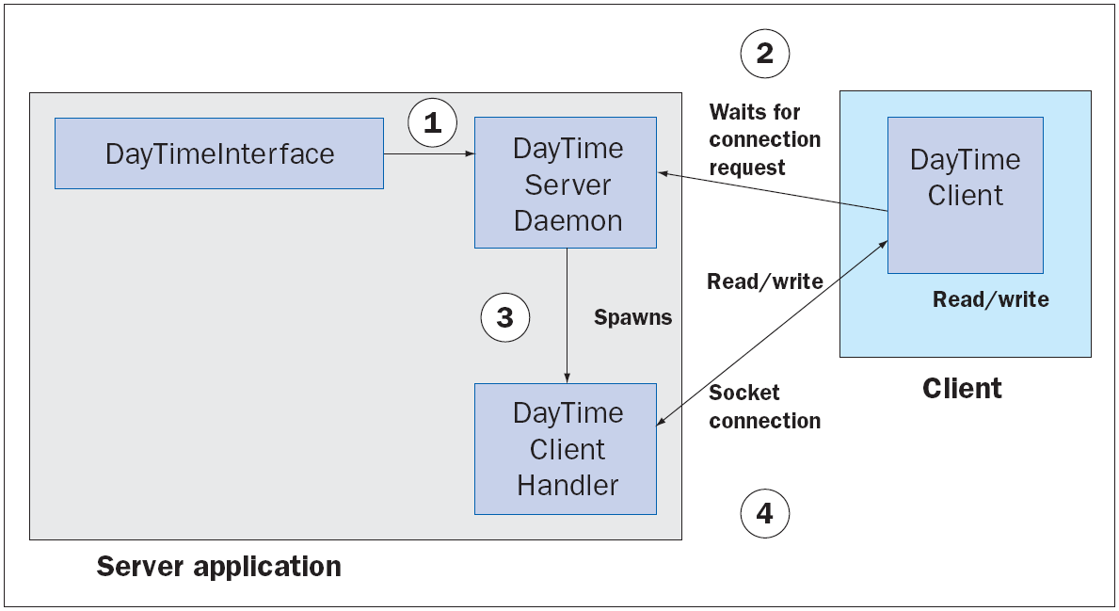
Networks, Clients, and Servers (continued)
Using a Server Daemon and Client Handlers (cont):
Day/time server daemon with client handler
‹#›
‹#›

Slide 31
Networks, Clients, and Servers (continued)
A Two-Way Chat Program:
The client connects to the server, and the two programs engage in continuous communication until one of them (usually the client) quits.
There are two distinct Java application for server and client.
The server handles only one client at a time, so you do not need separate server daemon and client handler classes.
The server program creates a socket with an IP address and port, then enters an infinite loop to accept and handle clients.
‹#›
‹#›

Slide 32
Networks, Clients, and Servers (continued)
A Two-Way Chat Program (cont):
When a client connects to the server, the server sends the client a greeting.
The server then enters a second, nested loop.
This loop engages the server and client in conversation.
If the server receives a “bye” message from the client, the server displays the message, closes the socket, and breaks out of the nested loop.
Otherwise, the server prints the client’s message and prompts the server’s user for a reply.
‹#›
‹#›

Slide 33
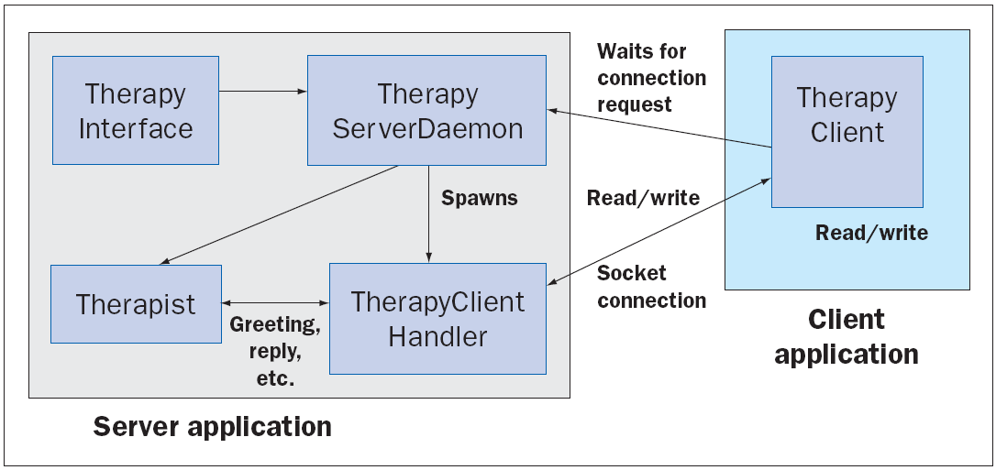
Networks, Clients, and Servers (continued)
Setting Up Conversations for Others:
The structure of a client/server program for clients and therapists.
‹#›
‹#›

Slide 34
Summary
In this chapter, you learned:
Threads allow the work of a single program to be distributed among several computational processes. These processes may be run concurrently on the same computer or may collaborate by running on separate computers.
A thread can have several states during its lifetime, such as new, ready, executing (in the CPU), sleeping, and waiting. The queue schedules the threads in first-come, first-served order.
‹#›
‹#›

Slide 35
Summary (continued)
After a thread is started, it goes to the end of the ready queue to be scheduled for a turn in the CPU.
A thread may give up the CPU when that thread times out, goes to sleep, waits on a condition, or finishes its run method.
When a thread wakes up, times out, or is notified that it can stop waiting, it returns to the rear of the ready queue.
‹#›
‹#›

Slide 36
Summary (continued)
Thread synchronization problems can occur when two or more threads share data. These threads can be synchronized by waiting on conditions that control access to the data.
Each computer on a network has a unique IP address that allows other computers to locate it. An IP address contains an IP number, but can also be labeled with an IP name.
‹#›
‹#›

Slide 37
Summary (continued)
Servers and clients can communicate on a network by means of sockets. A socket is created with a port number and an IP address of the server on the client’s computer and on the server’s computer.
Clients and servers communicate by sending and receiving strings through their socket connections.
A server can handle several clients concurrently by assigning each client request to a separate handler thread.
‹#›
‹#›

